Slide 1

Extension of Racial Disparities in Police Stops in U.S.
Time: 2020.12.23

Slide 2
Background and Extension
Stanford Team E.Pierson et al assessed racial disparities in policing in the United States by compiling and analysing a dataset detailing nearly 100 million traffic stops conducted across the country.
Their research is based on three aspects to see whether there are racial disparities or not: time period, potential bias in the post-stop to search drivers for contraband and changes of drug policy.
Their results indicate that police search decisions suffer from persistent racial bias.
All their process and results are in the paper A large-scale analysis of racial disparities in police stops across the United States.
We want to do extension on this.

Slide 3

Background and Extension
For extension, we aim to fursher analyze whether there exists racial bias. We focus on three aspects also, with introducing some new datasets crawled from website.
New datasets:
1.races.csv: data set contains the ethnic composition ratios of 21 states which have stop data(white, black, hispanic)
2.states info.csv: data set includes the population and ethnic composition of the blue and red states of the 21 states which are given traffic stop information(not including the swing states)
3.crime rates.csv: data set contains the number of offences and crime rate of various races in the United States from 2000 to 2019 released by the US Department of Justice
Three aspects:
1.race search coefficient and diverse state relationship
2.whether partisanship(red and blue state) has impact on racial discrimination
3.threshold coefficient and diverse state relationship

Slide 4
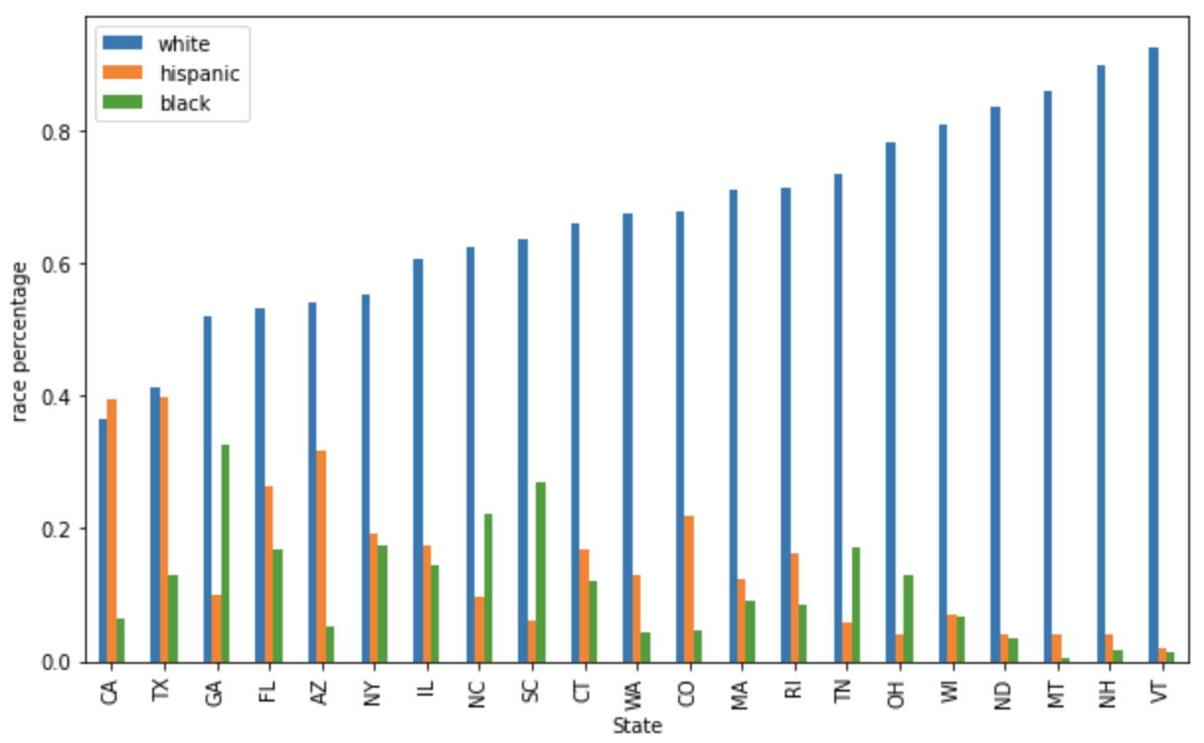
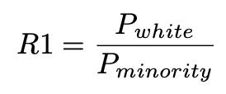
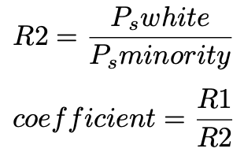
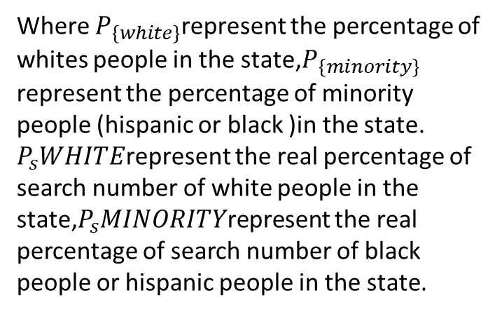
Extension Details
race search coefficient and diverse state relationship:
diverse state: the state which has diversified ethnic composition
poor-diverse state: the state which has an absolute majority of whites
Race search coefficient：
Where $P_{\left\{white\right\}}$represent the percentage of whites people in the state,$P_{\left\{minority\right\}}$ represent the percentage of minority people (hispanic or black )in the state. $P_{s}WHITE$represent the real percentage of search number of white people in the state,$P_{s}MINORITY$represent the real percentage of search number of black people or hispanic people in the state.
We assume that if the police treat drivers of all races equally,
$$Population ∗race_{1} percentage:Population ∗race_{2} percentage=race_{1} stop:race_{2}stop$$

Slide 5
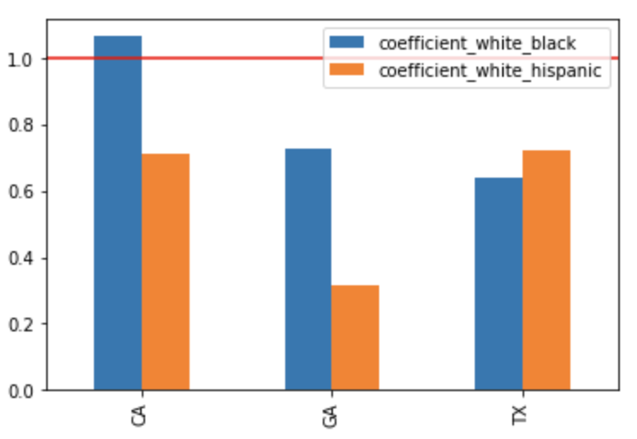
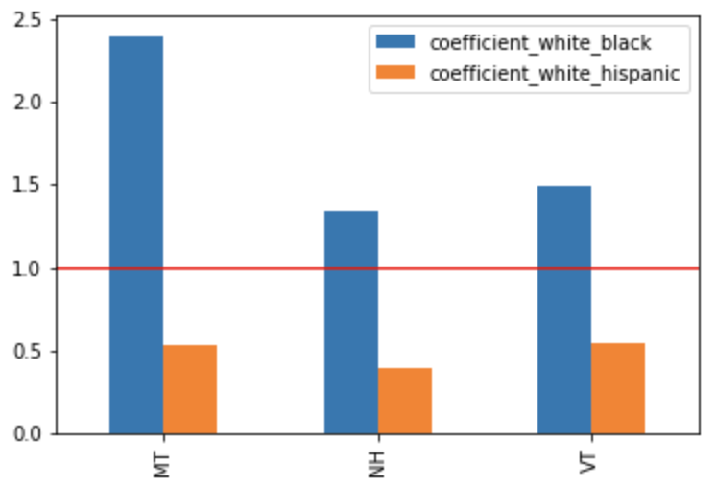
Extension Details
After calculation, we can see that in poor-diverse states, the coefficients between the black and the white are much greater than 1, which proves that police in these states are more inclined to search for black drivers.
diverse states
poor-diverse states

Slide 6
Extension Details
whether partisanship has impact on racial discrimination:
red states: Republican states
blue states: Democratic states
We find all red states and blue states among 21 states which have stop data and omit the swing states:
Red States:1.ND 2.SC 3.TX
Blue States: 1.CA 2.CT 3.IL 4.MA 5.NY 6.RI 7.VT 8.WA
First way: We treat all red states as a whole and all blue states as another whole, after that, we just compare between the two wholes.
Second way: according to similarity measure(mostly the distances between two samples), we find out three pairs of most similar red state and blue state, CA and TX, CT and SC, VT and ND. They are similar in population size, race ratio and so on. We compare them separately.

Slide 7
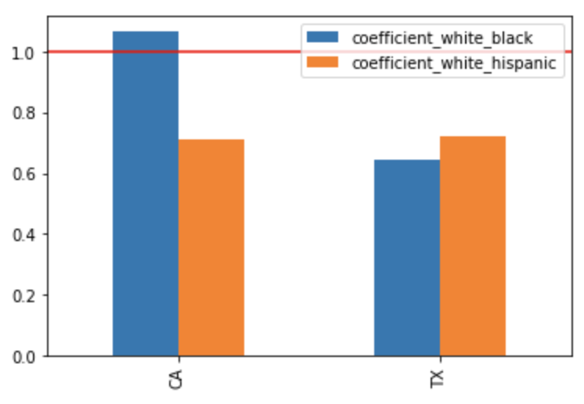
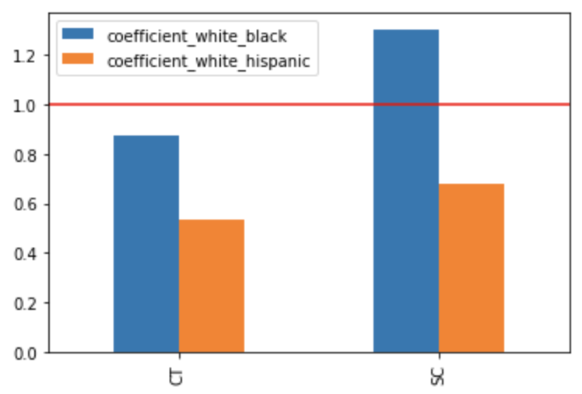
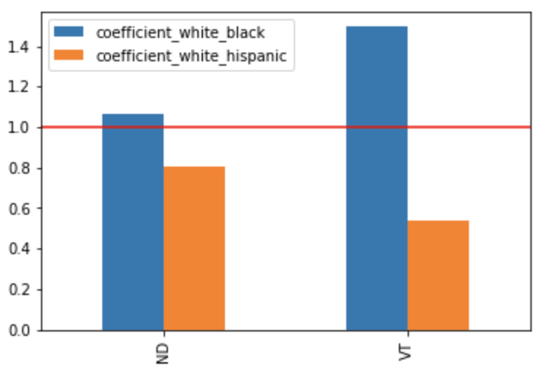
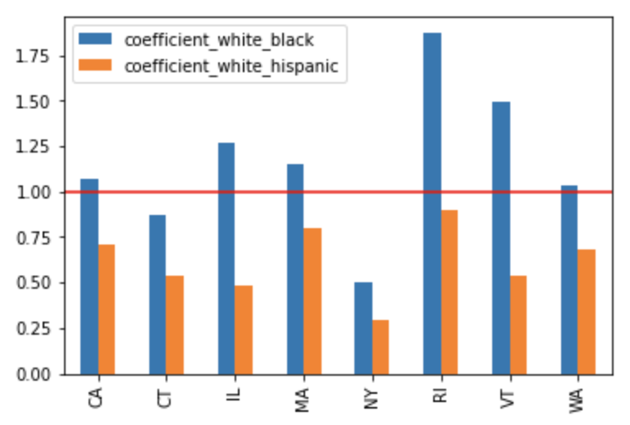
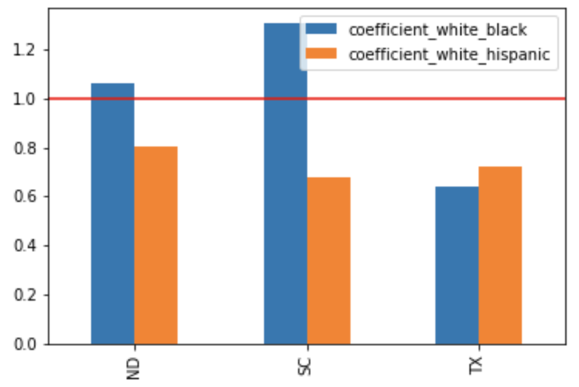
Extension Details
CA and TX
CT and SC
ND and VT
all blue states
all red states
After calculating race search coefficients, it is difficult to find obvious differences or regular patterns between the red states and blue states, which can't prove that political tendencies affect police searching decisions.

Slide 8
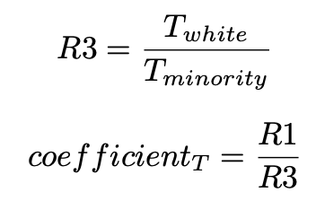
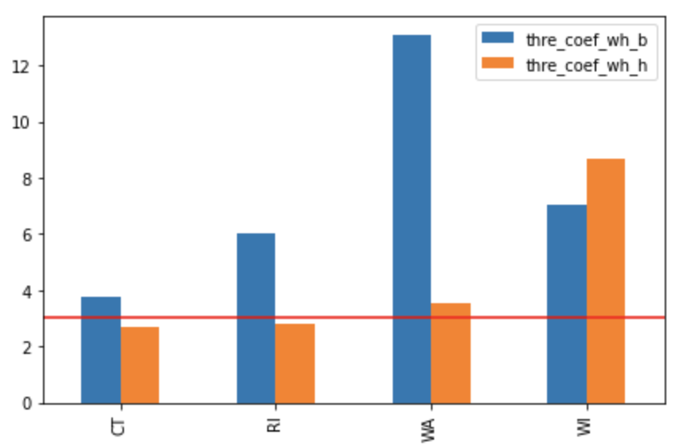
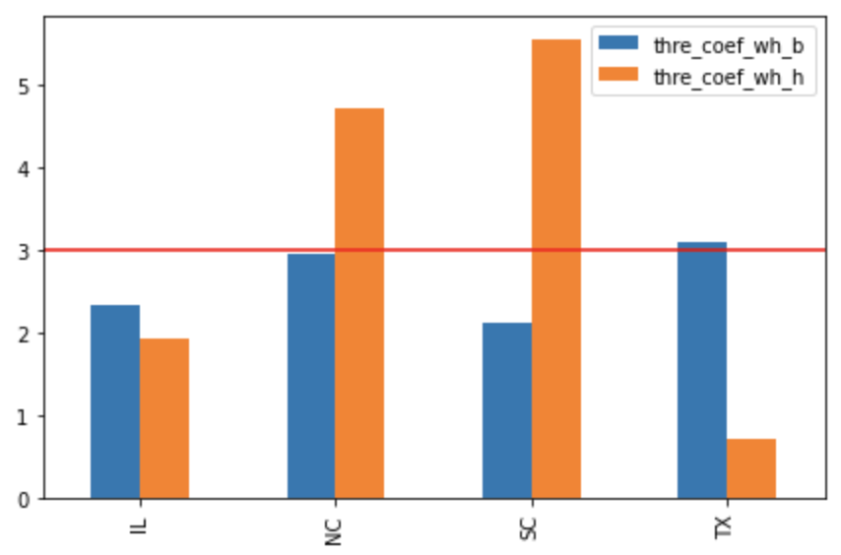
Extension Details
threshold coefficient and diverse state relationship:
According to the threshold, we define ratio and threshold coefficient like these:
If the threshold coefficient of poor-diverse states is much larger than diverse states, it represents that the population ratio is not in harmony with the threshold, which proves there exists bias in the police search behavior decision.
We could find that in poor diverse states, the threshold coefficient_wh_b are all larger than 3. This proves that in poor diverse states, the population composition is not commensurate with threshold, which indicates that there exists bias.
poor-diverse states
diverse states

Slide 9
Conclusion
Through the above methods, whether through the threshold coeffificient or the race coeffificient, black drivers are more likely to be stopped by the police than white drivers in a poor
diverse state.
In the diverse state, black drivers are treated fairly, but they are still more likely to be searched by the police
than white drivers.
Meanwhile in the existing data, there is no obvious data to support that hispanic drivers are affected by
racial factors in the decision-making process.We can conclude that the demographic composition of a state will have an impact on the police stop decision, and a state with a higher percentage of white people is more likely to be affected by racial discrimination.

Slide 10
THANK YOU

